Slide 1
BranchManager for DOORS
branchmanager@it-qbase.com

Slide 2
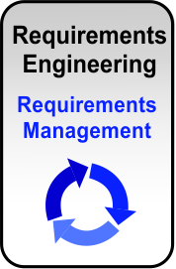
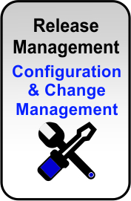
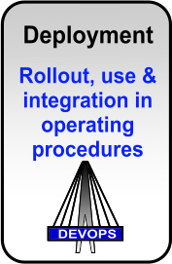
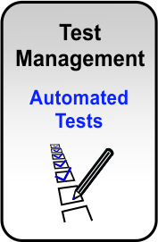
Company
Founded in 2003, located in Frankfurt, Germany
Managing Director: Adrine Hairapetian

Slide 3
Our Competence
Our core competence is to treat the comprehensive approach to Application Lifecycle Management (ALM) – from the requirement to the deployment
Our services range from the practical implementation of concrete results to strategic consultancy of middle and high management concerning potential capabilities and ways to handle ALM topics
Level
Require-ment
Design
Test
Build
Release
Config.
Change
Company wide
ALM Strategy
Consulting
Method & Processes
Project execution
Services
Long-term Services
Core Competence: end-to-end Lifecycle Management

Slide 4
Company profile
IT-QBase’ mission is to improve the engineering process through advanced interoperability solutions.
IT-QBase excels at:
collabrative lifecycle management and flow of Engineering data
Exchange and Synchronization of Engineering data
Customized and Optimized Generation of Engineering artifacts
the Amplification of Engineering expertise across an organization through automation tooling

Slide 5
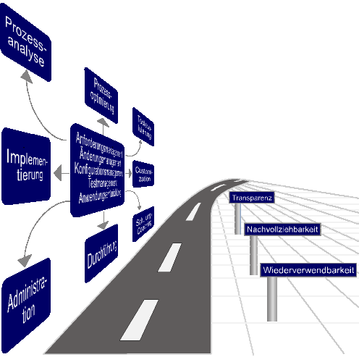
BranchManager for DOORS
Usage Patterns & Examples

Slide 6
Bridging gaps: Configuration Management for IBM Rational DOORS
DOORS BranchManager provides version and variant management for DOORS
Especially to create a base for fulfillment of authority rules like SPICE, DO178B/C, EN50128, IEEE 1558, CMMI, IRIS
This solution will be successfully used in the industries Aerospace, Transportation, Automotive, Telecommunication and Government

Slide 7
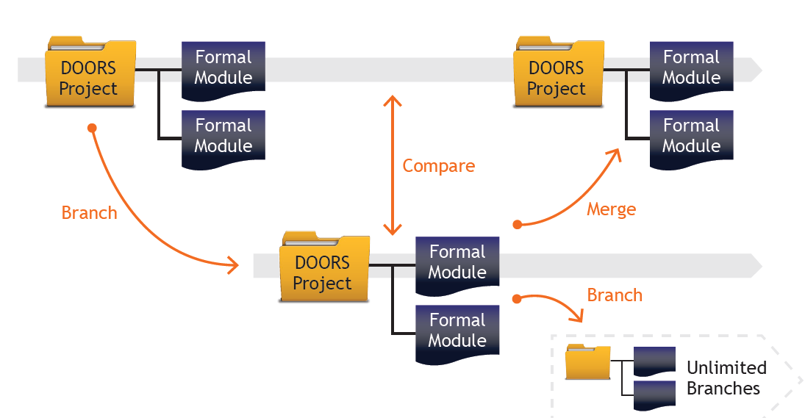
Requirements Engineering BM Overview
DOORS BranchManager provides Stream management to Rational DOORS
Challenge: Manage similar requirements set across many projects
Provide the ability to compare formal modules with differences in content and structure
Provide the ability to branch sets of modules as a new stream of requirements
Provide the ability to merge changes across branches
BranchManager for DOORS Usage
Product Line Engineering
Maintenance Streams
Requirements Library
Personal Sandbox
…

Slide 8
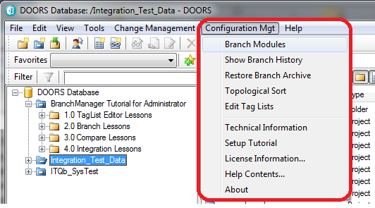
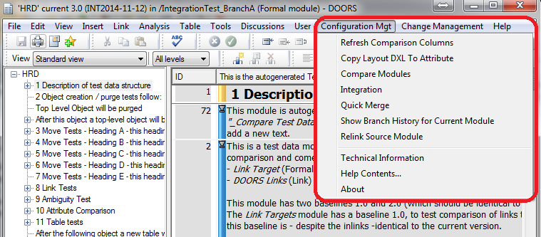
DOORS BranchManager Get Impressions
Fully integrated in DOORS Database Explorer and Module window

Slide 9
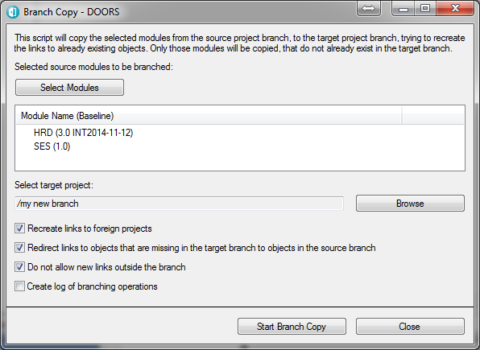
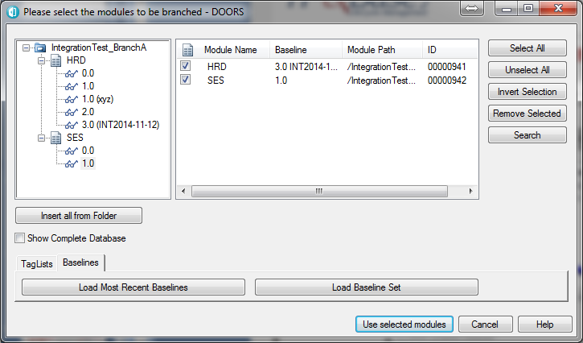
DOORS BranchManager Get Impressions
Branch modules
Choose modules and baselines

Slide 10
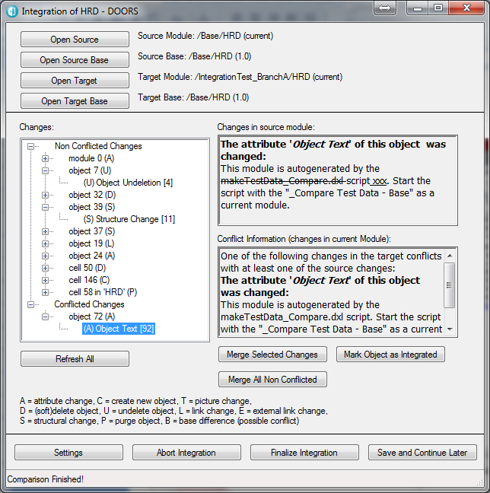
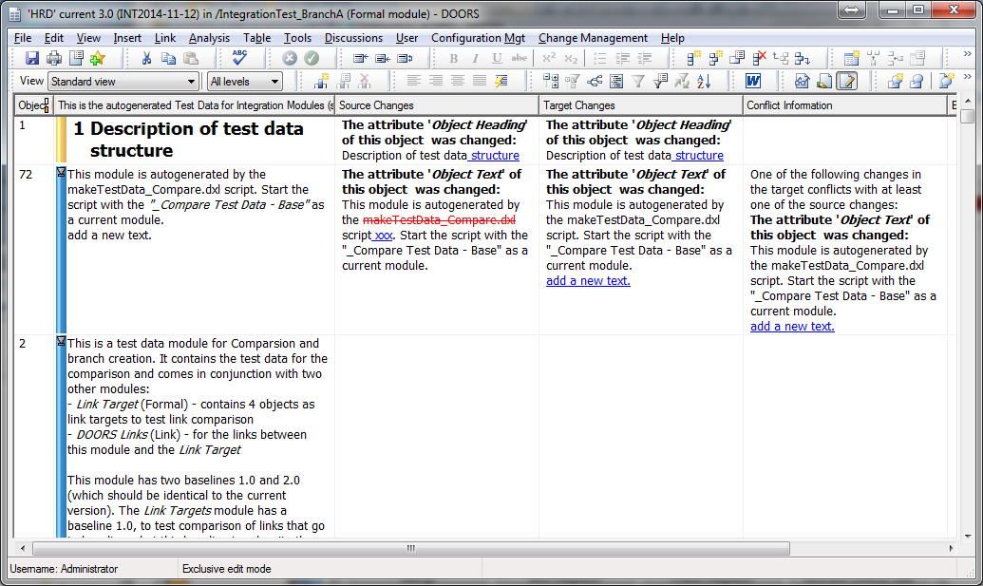
DOORS BranchManager Get Impressions
Merge Modules

Slide 11
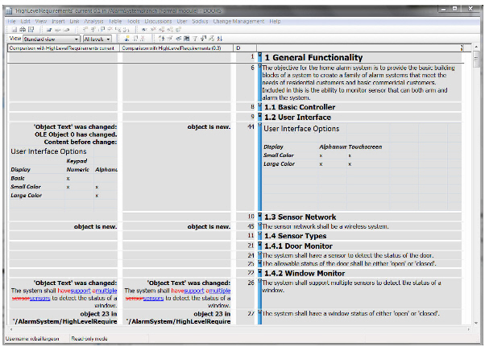
DOORS BranchManager Get Impressions
Compare
Modify / delete/ add
Text attributes
OLE-Attributes
DOORS pictures
DOORS tables
Link changes
Object displacements
Comparison mechanism identifies differences between baselines and across branches
Its intelligent comparison engine can compare based on a selectable list of attributes…
…and can detect changes in attributes, OLE objects, links and structural changes such as moving a requirement in the hierarchy.

Slide 12
Pattern: Maintenance Branch
What
- Branch off the main development to support released product
Why
- Enable a clear separation of current development and released and maintained assets
Project Development
R1
R2
R3
R4
Branch
R2
R2.1
Project Maintenance R2
Apply Fix

Slide 13
Pattern: Personal Sandbox & Change Evaluation
What
Branch off the main development to individual development
Why
Enable a clear separation of current approved content
Enables simultaneous development without conflict
Enables the selective inclusion of changes
Evaluation of changes before being shared
Apply Change
Bob
Reject &
Not Share
Shared Development
Branch
Approve &
Share
Branch
Sally
Apply Change

Slide 14
Pattern: Shared Requirements
What
-Baseline set of requirements set over an entire product base. Boilerplate requirements, baseline capabilities, “platform” requirements.
Why
Common sets of requirements are common across multiple products
Subset & extend requirements
Identify changes and merge updates from the common set.
Update the core requirements
Standard
Requirements
Clone &
Subset
Review &
Update
Product A
Clone &
Extend
Don’t Take
Changes
Product B

Slide 15
Pattern: Derivative Product
What
Creation of a new product as a subset or extension of an existing product
Why
Allows rapid creation of a new product
Still enables sharing across products
Product A (Original)
Clone &
Modify
Review &
Update
Product B
Clone &
Extend
Take
Changes
Product C

Slide 16
BranchManager Solution
DOORS® Projects become Branches
- Containerizes concepts and naturally contributes
Object Relationships captured in Metadata
- Available in tooling to enhance functionality to the user
Comparison Technology presented in DXL layout
- Provides view flexibility and efficient update performance
Three way merge solution for “pull-basis”
- Common parent eases change assessment and merge choices
Quick merge
- Enables update to multiple streams at once

Slide 17
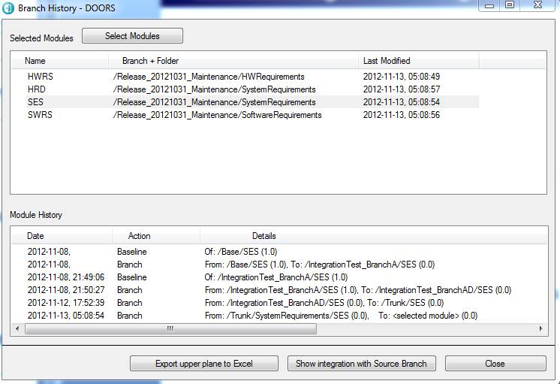
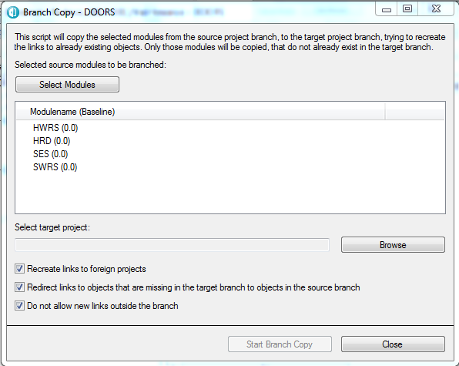
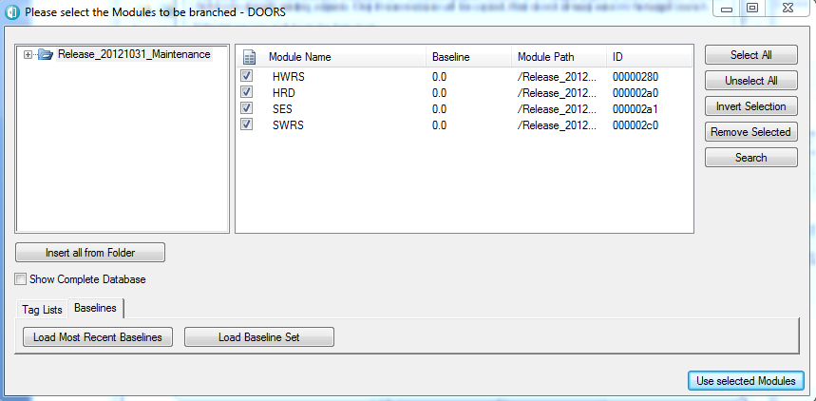
BranchManager Branching
Branch Replicates
Structure and Content
Creating a Branch

Slide 18
BM Branching – Link Manager
DOORS
Project
Folder
FM
DOORS
Project
Folder
FM
Folder
FM
FM
Folder
FM
FM
FM
FM
Redirected Link in Target Branch
DOORS
Project
FM
Full Branch
FM
Original Database
DOORS
Project
Folder
FM
Link To Foreign Project Enabled or Disabled
Folder
FM
FM
Scope of Branch Prunes Links
Partial Branch

Slide 19
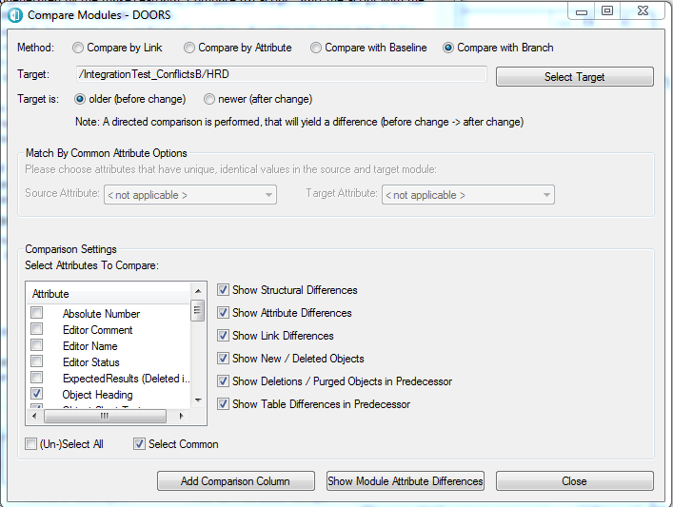
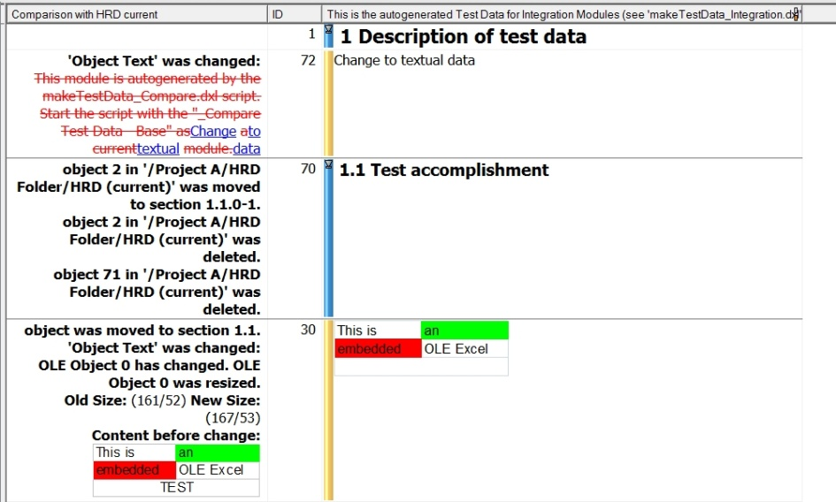
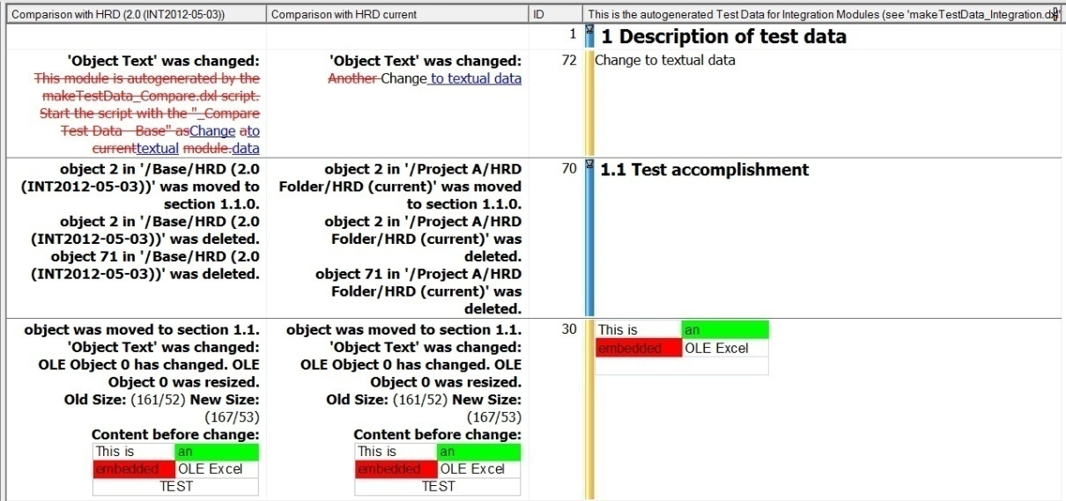
BranchManager Comparison
Detected Changes
Modification/Deletion/Addition
Textual Attributes
OLE Attributes
Images
DOORS Tables
Link Changes
Object Movement

Slide 20
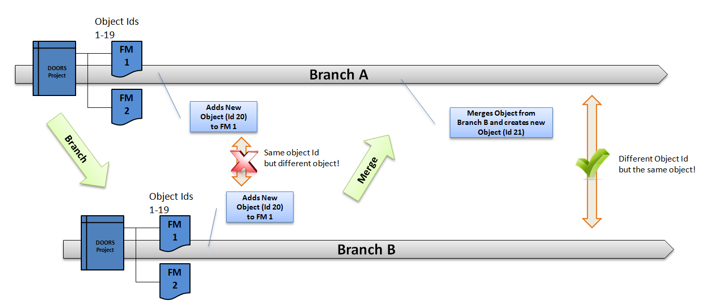
BM Comparison Object Identification
Why Object Ids alone don’t work
Not globally unique
No knowledge on branches
Same Object Id for different objects
Different Object Id for the Same Object

Slide 21
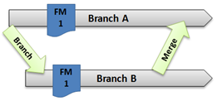
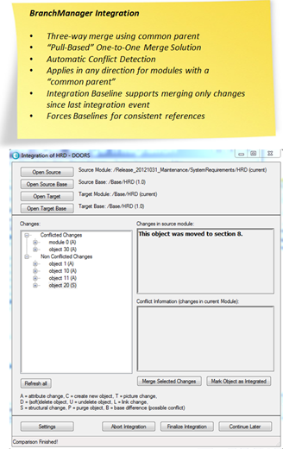
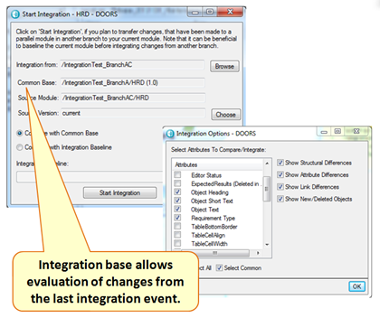
BranchManager – Merge Integration

Slide 22
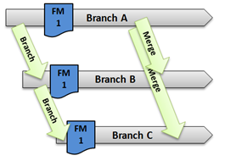
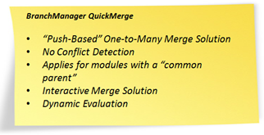
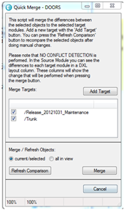
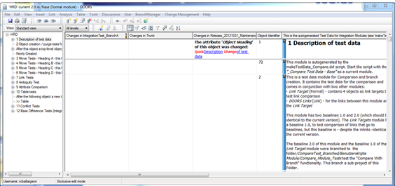
BranchManager – Quick Merge

Slide 23
Conclusions
BranchManager Provides Core Needed Capabilities
Reuse for reduced investment and higher quality
Gatekeeping for quality controls and reviews
Cloning for rapid new derivative products, yet still linked
Flexible Adoption
Applicable to many user scenarios
Strong foundation resolving major challenges of configuration management in DOORS
Configurable to an organization’s specific practices

Slide 24
Consulting and Support LCM
IT-QBase GmbH
Hanauer Landstraße 114-116
60314 Frankfurt
Deutschland
Tel. +49 (0) 69 – 366 021 26
Fax +49 (0) 69 – 366 021 27
Web: www.IT-QBase.de
Mail: BranchManager@IT-QBase.de

